Slide 1
Data Structures
Lecture -4

Slide 2
Data Structures
Definition : Arranging the data object in order is called Data Structure so that it can be used efficiently.
It is an organization of mathematical and logical concepts of data.

Slide 3
Data Structures( Contd. )
Linear Data Structures: arranging the data in sequential order. It is also known as Homogeneous Data Structures.
Stack, Queue, Lists
Non Linear Data Structures: arranging the data in arbitrary memory location. It is also known as Non Homogeneous Data Structures.
Binary Trees, Graphs, AVL Trees, B Trees

Slide 4
Abstract Data Type
An abstract data type (ADT) is the specification of a data type within some language independent of an implementation. The interface for the ADT is defined in terms of a type and a set of operations on that type. The behaviour of each operation is determined by its inputs and outputs.
An ADT does not specify how the data type is implemented. These implementation details are hidden from the user of the ADT and protected from outside access, a concept referred to as encapsulation.

Slide 5
Algorithm
Input
Algorithm
Output
An algorithm is a step-by-step procedure for solving a problem in a finite amount of time.

Slide 6
Stacks
Definition: Stack is an ordered collection of items in which all insertion and deletion are made at one end, called the top. Stack follows the Last In First Out (LIFO). ie., Last inserted element removes First.
Stack operations
insertion operation is called push.
Deletion operation is called pop.

Slide 7
Stack(Contd.)
Initial stack with size 5
push
pop
top=-1
stk

Slide 8
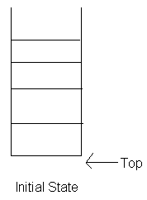
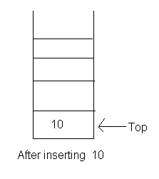
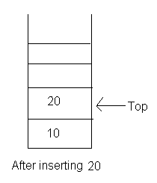
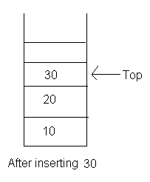
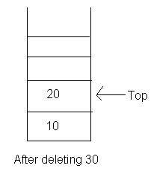
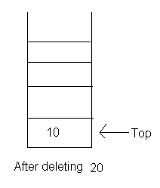
Stack(Cont.)

Slide 9
Stack(Contd.)
The simplest way to represent a stack is by using a one-dimensional Array say stack[0 : n-1 ], where n is the maximum number of allowable entries.
Another way to represent a stack is by using links. A node is a collection of data and link information. A stack can be represented using nodes with two fields, possibly called data and link.

Slide 10
Stack – push operation
Algorithm push( item ){
Input: item to be inserted
Output: return true if successful, else false.
If ( top >= n-1 ) then
Write(“ Stack is full “); return false;
else
top <= top+1;
Stack[top] <= item;
return true;
}

Slide 11
Stack – pop operation
Algorithm pop( item ){
Input: item to be removed
Output: return true if successful and else false
If ( top < 0) then
write( “ Stack is empty “); return false;
else
item <= stack[top];
top <= top – 1;
return true;
}

Slide 12
Thank You

